Slide 1
Intro to Rocketry

Slide 2
What is a rocket?
According to NASA, a rocket is “A vehicle, typically cylindrical, containing liquid or solid propellants which produce hot gases or ions that are ejected rearward through a nozzle.”
Notes:
Have the kids answer the question first

Slide 3
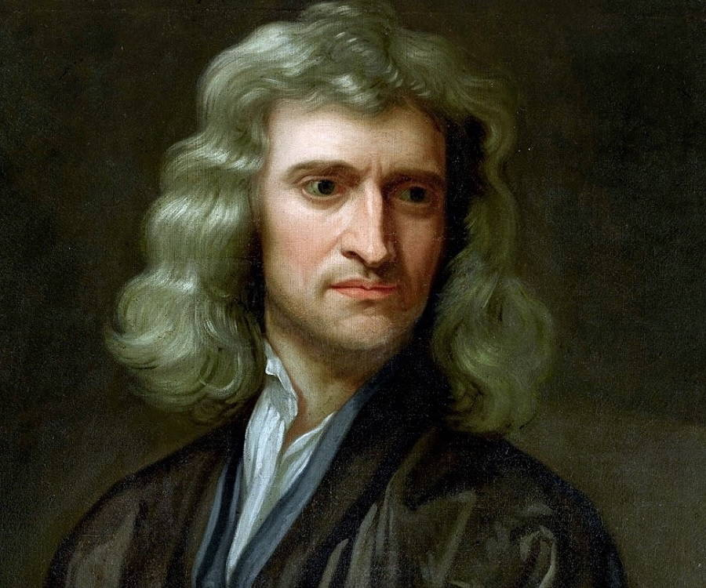
Newton’s Laws of Motion
An object at rest or at constant velocity will remains so until acted upon by an external force. (Law of inertia)
The net force on an object equals the force applied times its acceleration. (F = ma)
For every action, there is an equal and opposite reaction.
Notes:
How do these three laws relate to rocketry?

Slide 4
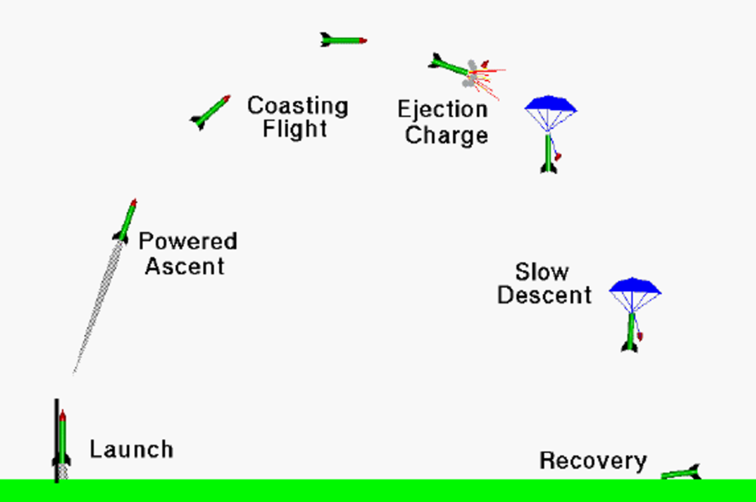
Flight of a Model Rocket
Notes:
Talk about velocity and acceleration at each point

Slide 5
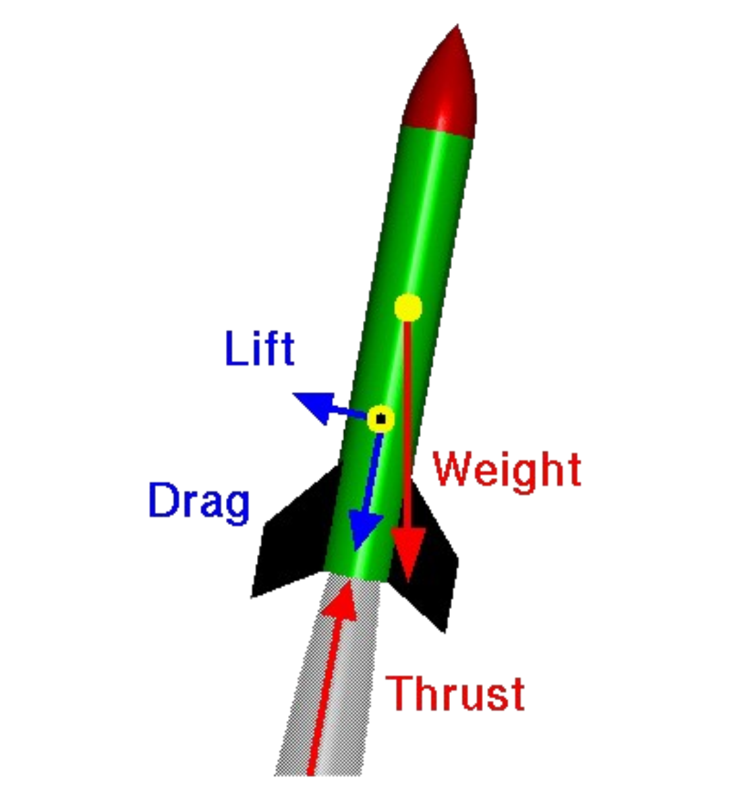
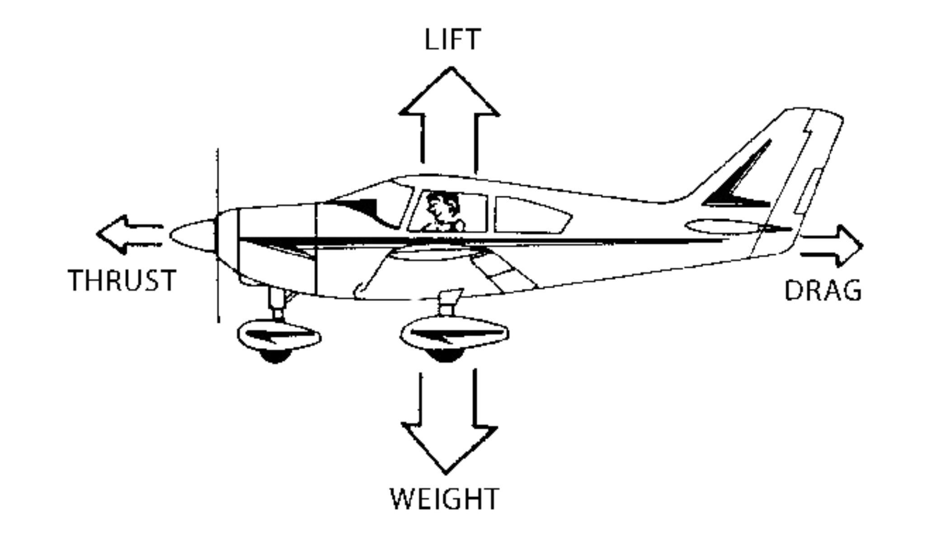
Forces on a Rocket and Airplane
Notes:
Drag – depends on surface area
Lift – less relevant on rockets, but is due to fins – caused by angle of attack

Slide 6
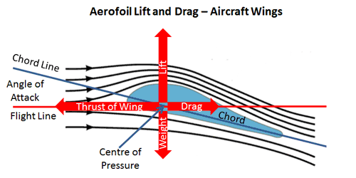
Lift Force
Notes:
Drag – depends on surface area
Lift – less relevant on rockets, but is due to fins – caused by angle of attack

Slide 7
01
ASTRONOMICAL OBSERVATORY
You could enter a subtitle here if you need it

Slide 8
ELECTROMAGNETIC SPECTRUM
Do you know what helps you make your point clear? Lists like this one:
They’re simple
You can organize your ideas clearly
You’ll never forget to buy milk!
And the most important thing: the audience won’t miss the point of your presentation

Slide 9
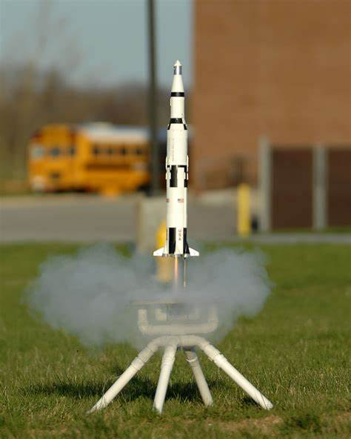
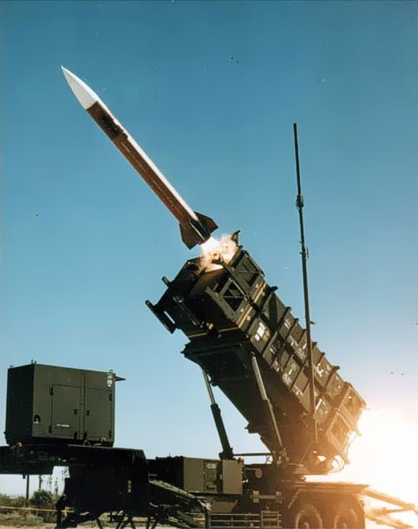
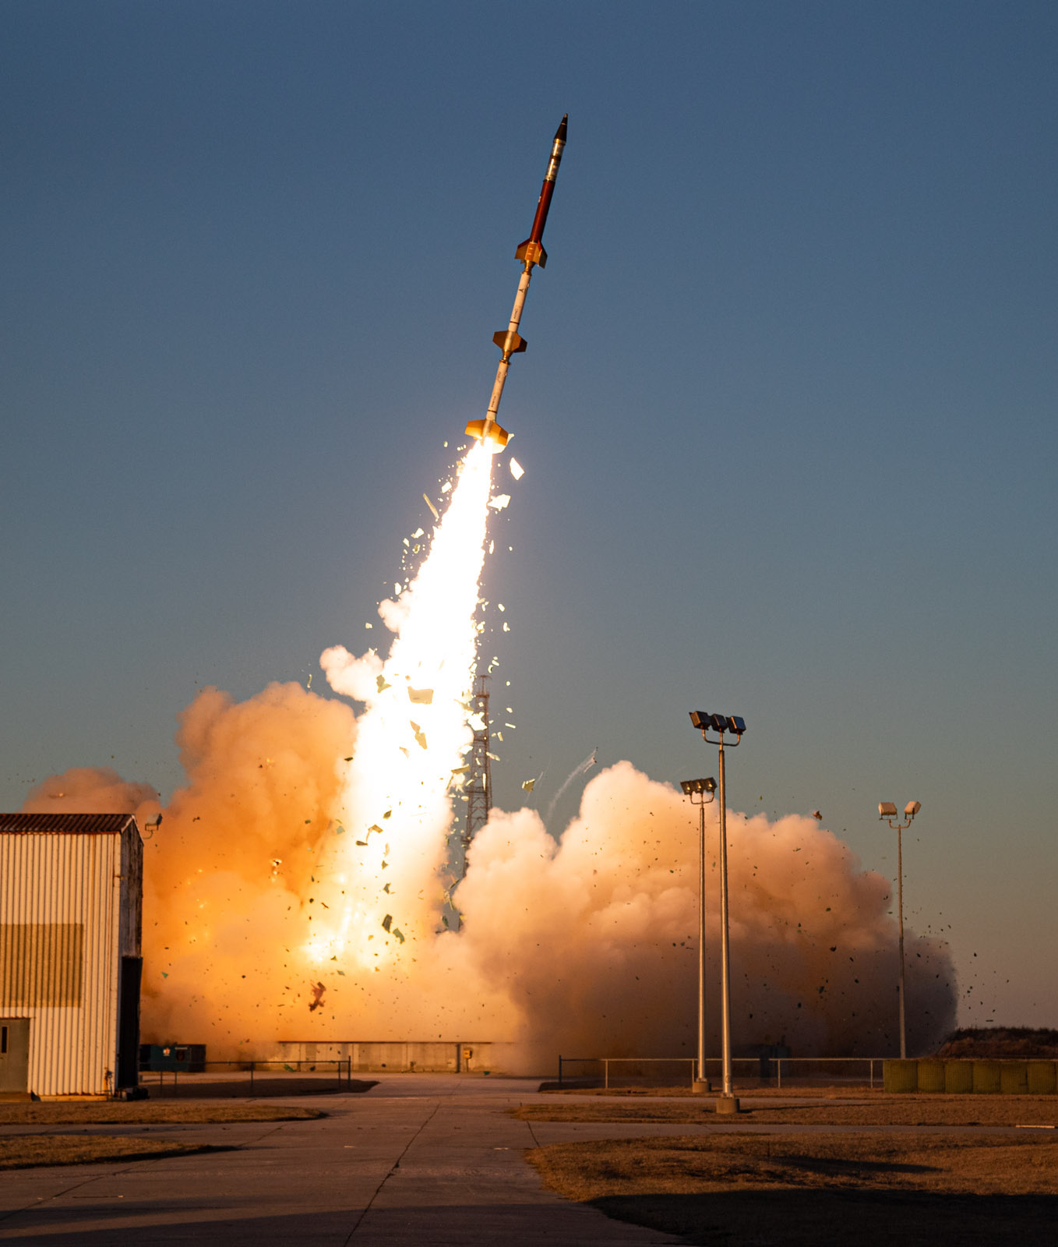
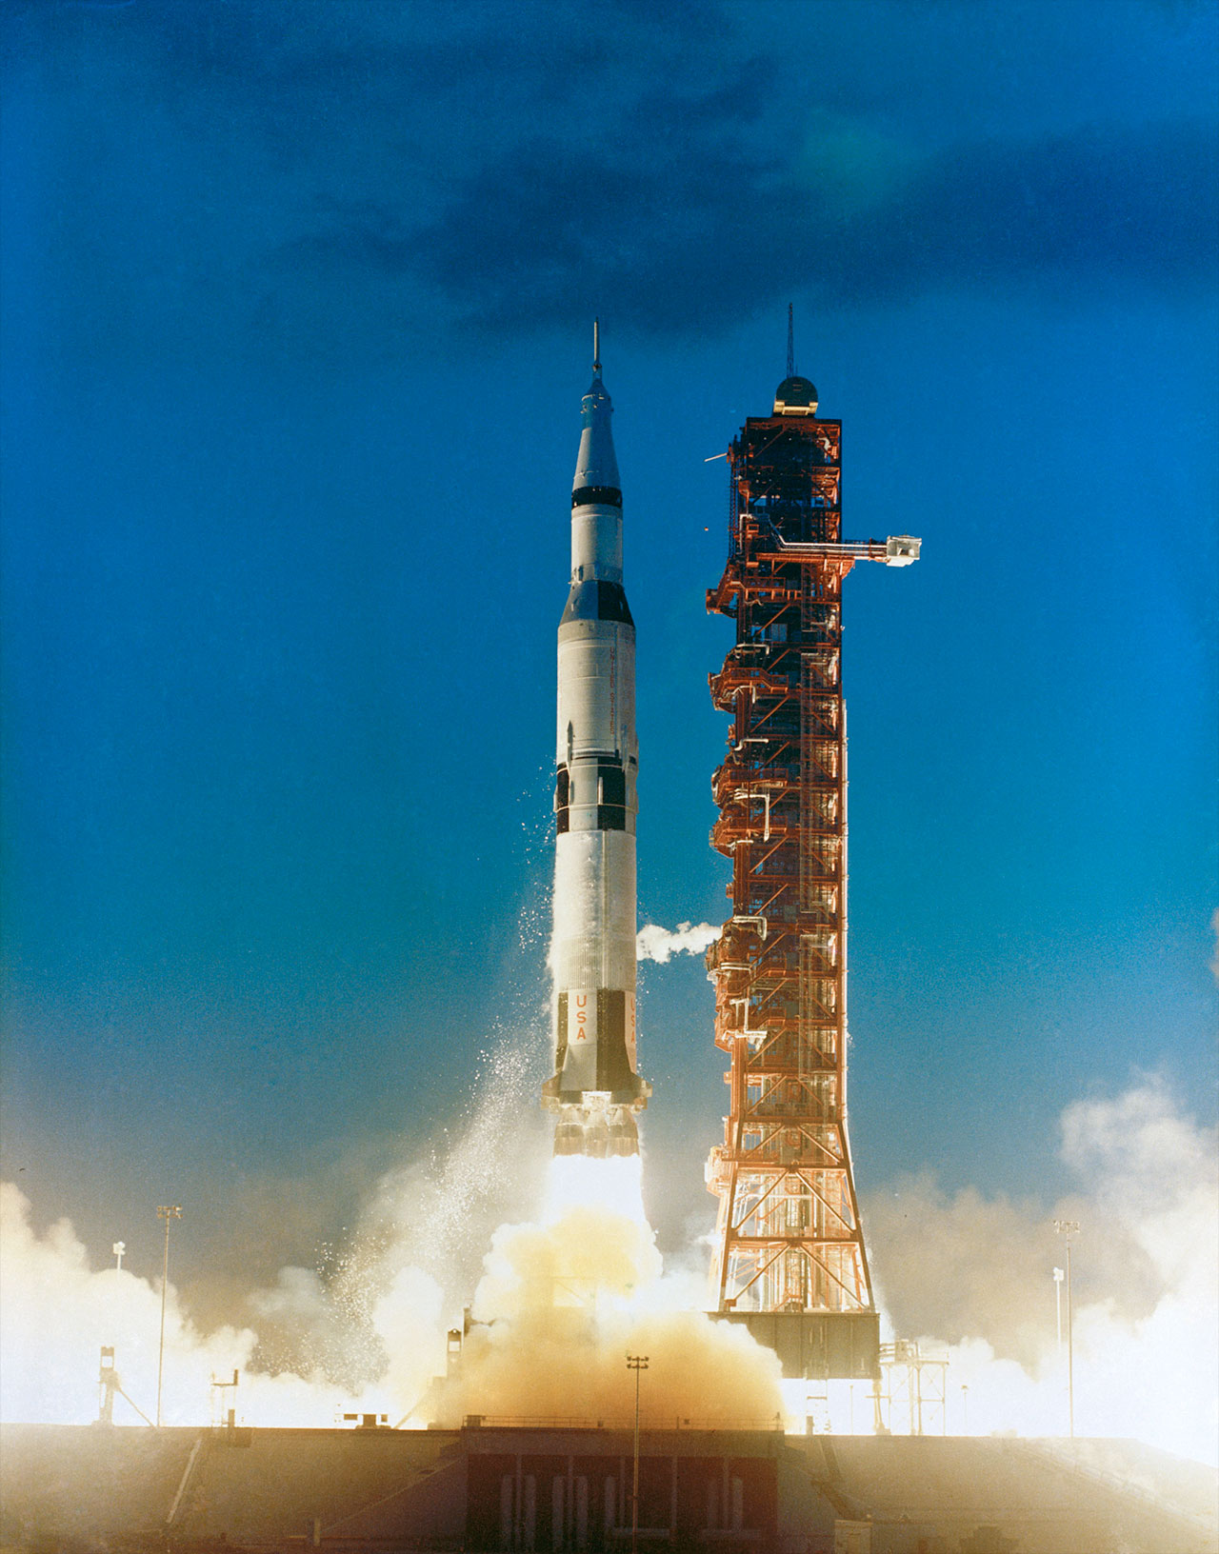
Uses of Rocketry
Hobby
Missles
Sounding Rockets
Launch Vehicles
Notes:
Sounding rockets – Rockets carrying scientific instruments into the upper atmosphere to take measurements of things like air quality and radiation in the air

Slide 10
OBSERVE EARTH SATELLITES
VENUS
MERCURY
Venus is the second planet from the Sun
Mercury is the closest planet to the Sun
MARS
JUPITER
Despite being red, Mars is a cold place
Jupiter is the biggest planet in the Solar System

Slide 11
STUDY CELESTIAL SOURCES
MERCURY
JUPITER
Mercury is the closest planet to the Sun
Jupiter is the biggest planet of them all
VENUS
SATURN
Venus is the second planet from the Sun
Saturn is composed mostly of hydrogen and helium
NEPTUNE
MARS
Neptune is the farthest planet from the Sun
Despite being red, Mars is actually a cold place

Slide 12
AWESOME WORDS

Slide 13
—SOMEONE FAMOUS
“This is a quote. Words full of wisdom that someone important said and can make the reader get inspired.”

Slide 14
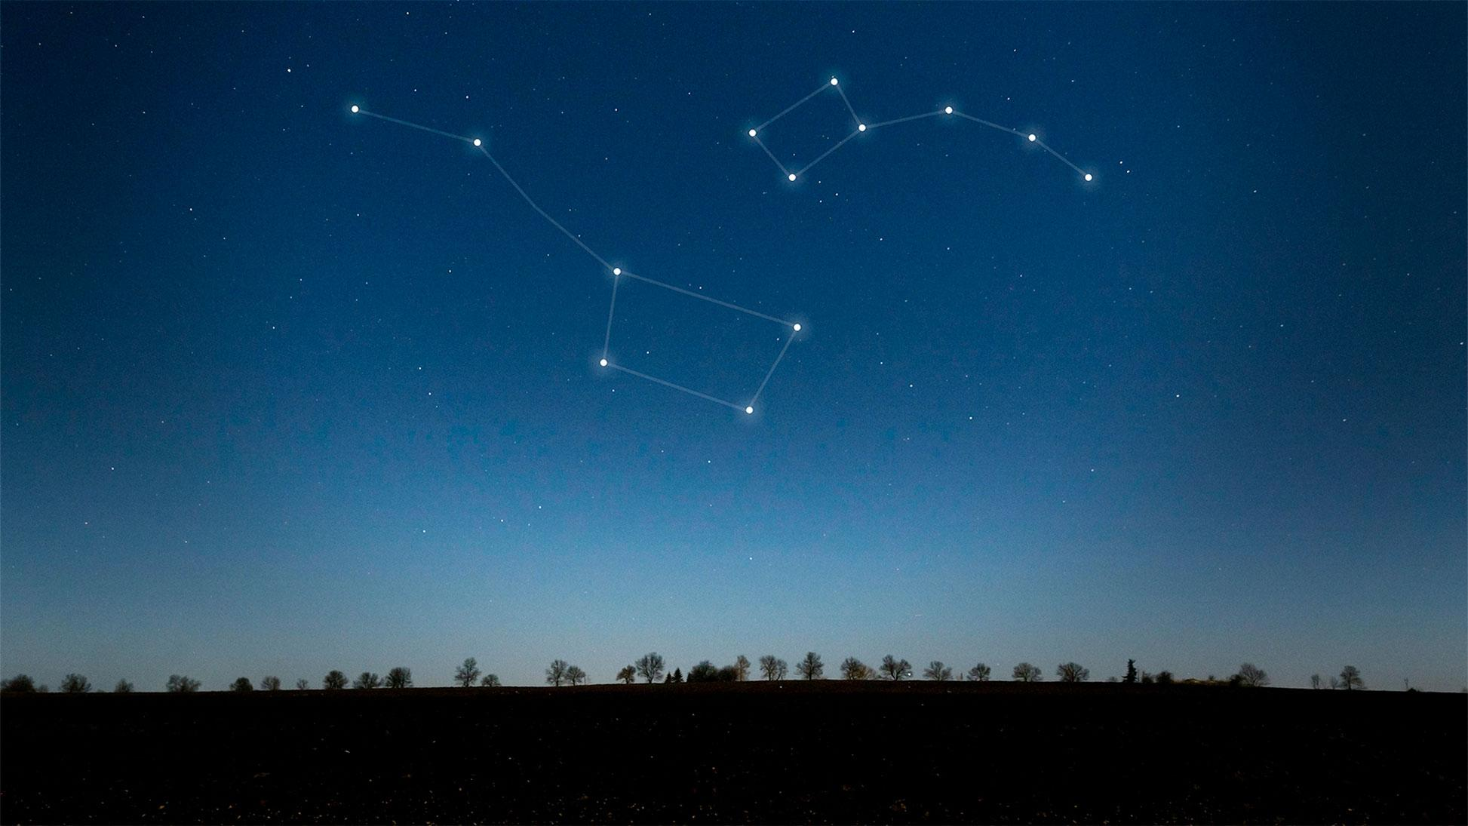
A PICTURE IS WORTH A THOUSANDS WORDS

Slide 15
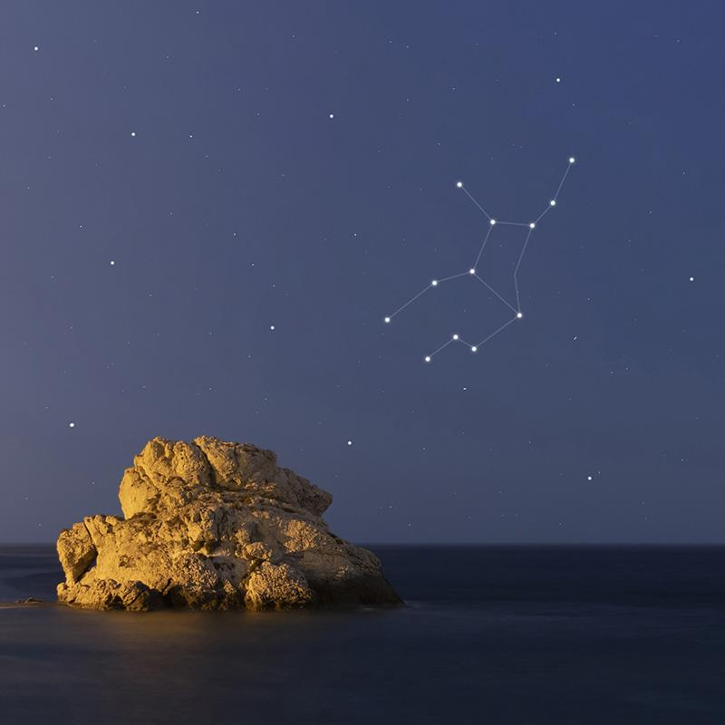
A PICTURE REINFORCES THE CONCEPT
Images reveal large amounts of data, so remember: use an image instead of a long text. Your audience will appreciate that

Slide 16
489,300.00
Big numbers catch your audience’s attention

Slide 17
24.000
33.300
38.600
Jupiter is a gas giant and the biggest planet
Saturn is a gas giant and has several rings
Neptune is the farthest planet from the Sun

Slide 18
02
OUR TELESCOPES
You could enter a subtitle here if you need it

Slide 19
THE OPTICAL TELESCOPE
40%
80%
MERCURY
VENUS
It’s the closest planet to the Sun and the smallest one
Venus has a beautiful name and is the second planet

Slide 20
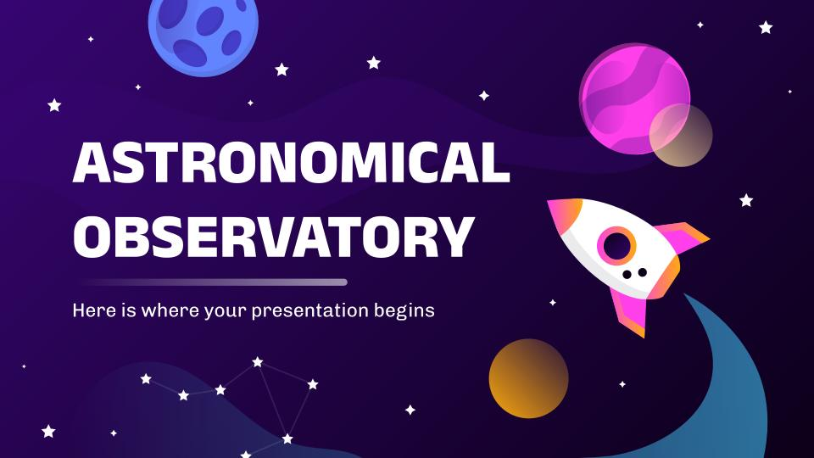
TELESCOPE SOFTWARE
You can replace the image on the screen with your own work. Just right-click on it and select “Replace image”

Slide 21
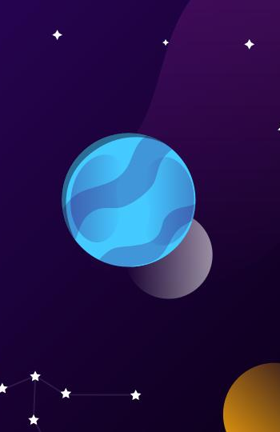
ASTRONOMIC WEBSITE
You can replace the image on the screen with your own work. Just right-click on it and select “Replace image”

Slide 22
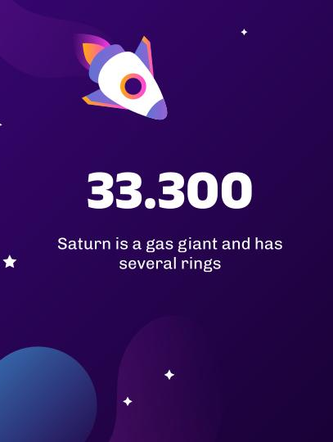
TABLET APP ABOUT STARS
You can replace the image on the screen with your own work. Just right-click on it and select “Replace image”

Slide 23
TELESCOPE MAP
JUPITER
Jupiter is a gas giant and the biggest planet
VENUS
Venus is the second planet from the Sun
NEPTUNE
Neptune is the farthest planet from the Sun

Slide 24
HISTORY OF OBSERVATION
1609
1789
1930
TODAY!
VENUS
MARS
MERCURY
NEPTUNE
Venus has a beautiful name
Mars is a very cold place
It’s the closest from the Sun
It’s the farthest from the Sun

Slide 25
OBSERVED CELESTIAL OBJECTS
1ST
3RD
2ND
4TH
MERCURY
JUPITER
Mercury is the closest planet
Jupiter is a gas giant planet
MARS
NEPTUNE
Mars is actually a cold place
Neptune is an ice giant planet

Slide 26
TYPES OF OBJECTS
EARTH | Earth is the planet with life | Earth is known as the blue planet | All humans live on this planet
MARS | Mars is actually a cold place | Mars is full of iron oxide dust | Mars was named after a god
MERCURY | Mercury is a very small planet | It’s the closest planet to the Sun | Mercury is the smallest of them
VENUS | Venus has high temperatures | Venus has a toxic atmosphere | Venus has a beautiful name

Slide 27
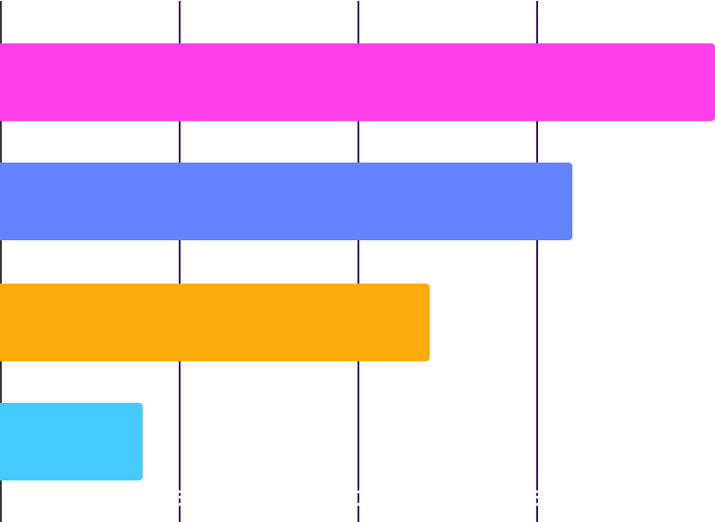
ASTRONOMICAL INSTRUMENTS
1,000
600
800
400
MERCURY
JUPITER
Mercury is the closest planet
Jupiter is a gas giant planet
MARS
NEPTUNE
Mars is actually a cold place
Neptune is an ice giant planet
Follow the link in the graph to modify its data and then paste the new one here. For more info, click here

Slide 28
03
SATELLITE OBSERVATORIES
You could enter a subtitle here if you need it

Slide 29
OUR SATELLITES
MERCURY
VENUS
Mercury is the closest planet to the Sun and the smallest one
Venus has a beautiful name and is the second planet

Slide 30
RANGE OF SATELLITES
5/25
10/25
15/25
20/25
MERCURY
SATURN
MARS
VENUS
It’s the closest planet to the Sun
Saturn is a gas giant planet
Despite being red, Mars is cold
Venus is the second planet

Slide 31
OBSERVATION PLANNING
 | January | February | April | May | June
TASK 1
TASK 2
TASK 3
TASK 4
TASK 5

Slide 32
SATELLITE POSITIONS
90°
30°
60°
0°
MERCURY
JUPITER
Mercury is the closest planet
Jupiter is a gas giant planet
MARS
NEPTUNE
Mars is actually a cold place
Neptune is an ice giant planet

Slide 33


OUR TEAM
CRISTINA SHARP
OLIVER PATH
Here you can talk a bit about this person
Here you can talk a bit about this person

Slide 34
THANKS!
Do you have any questions?
youremail@freepik.com
+91 620 421 838
yourcompany.com
Please keep this slide for attribution

Slide 35
ALTERNATIVE RESOURCES
Here’s an assortment of alternatives resources within the same style of this template
VECTORS
Gradient galaxy background I
Gradient galaxy background II

Slide 36
RESOURCES
Did you like the resources? Get them for free at our other websites.
VECTORS
Gradient space with a rocket I
Gradient space with a rocket II
Gradient space with a rocket III
Gradient galaxy background I
Gradient galaxy background II
Gradient galaxy background III
Gradient galaxy with rocket
Star background
PHOTOS
Beautiful constellations on sky
Virgo constellation on a beautiful starry night
Woman studying in the library
Man between bookshelves

